Slide 1
S-Layers
Introduction:
Crystalline bacterial cell-surface layers (S-layers) have been optimized during billions of years of biological evolution as one of the simplest biological membranes
S-layers are composed of a single protein or glycoprotein species endowed with the ability to assemble into monomolecular arrays on the supporting cell envelope component of prokaryotic organisms.
The information accumulated on the structure, chemistry, assembly, genetics, and function of S-layers has led to a broad spectrum of applications for life and material sciences

Slide 2
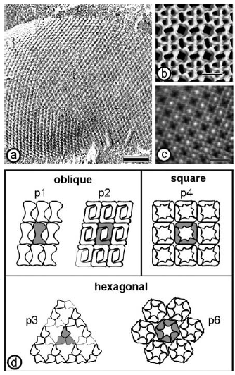
Structure
Figure: (a) Freeze-etching preparation of whole cells of Thermoanaerobacter thermohydrosulfuricus L111-69 revealing a hexagonally ordered array. Scale bar = 100nm. (b) Three-dimensional model of the S-layer of Bacillus stearothermophilus NRS 2004/3a/V2 exhibiting oblique lattice symmetry. The protein meshwork shows one square shaped, two elongated, and four small pores per morphological unit. (c) Computer image reconstruction of scanning force microscopic images of the topography of the square S-layer lattice from Bacillus sphaericus CCM 2177. The images were taken under water. The surface corrugation corresponding to a gray scale tram black to white is 1.8 nm. Scale bars in (b) and (c) = 10 nm. (d) Schematic drawing of the different S-layer lattice types. The regular arrays exhibit either oblique (p1, p2), square (p4), or hexagonal lattice symmetry (p3, p6). The morphological units are composed of one, two, three, four, or six identical subunits. (Reproduced from Ref. [3], with permission from Wiley-VCH.)

Slide 3
Chemistry
S-layers composed of single homogeneous protein or glycoprotein species
Weakly acidic proteins (pI = 4–6), except Methanothermus fervidus (pI = 8.4) and Lactobacilli (pI = 9.5)
Molecular weights ranging from 40 to 200 kDa.
Post translational modifications in S-layer proteins, includes
Cleavage of amino- or carboxy-terminal fragments,
Phosphorylation
Glycosylation of amino acid residues.
Glycosylation of amino acid residues is a characteristic of many archaeal and some bacterial S-layer proteins
These glycan chains and linkages differ significantly from those of eukaryotes.

Slide 4
Structure
In most S-layer proteins, ~ 20% of the amino acids are organized as α-helix, and about 40% occur as β-sheets
The proteinaceous subunits of S-layers can be aligned in lattices with oblique, square, or hexagonal symmetry
Center-to-center spacing of the morphological units of between 3 and 35 nm.
S-layers are porous membranes, with pores occupying 30 to 70% of their surface area
In both Gram-positive bacteria and archaea, the lattice assembles on the surface of the cell-wall matrix
In Gram-negative bacteria the S-layer is attached to the outer membrane

Slide 5
Genetics and Secondary Cell-Wall Polymers
S-layer genes from organisms of different taxonomic affiliations have been cloned and sequenced.
Considering the competitive situation of closely related organisms in their natural habitats, the S-layer surface must contribute to diversification rather than to conservation.
Achieved by S-layer variation leading to the expression of different types of S-layer genes, or to the recombination of partial coding sequences.
S-layer variation studied in Campylobacter fetus, an important pathogen for humans and ungulates but was also observed for nonpathogens such as Geobacillus stearothermophilus
High sequence identities are limited to the N-terminal region

Slide 6
Genetics and Secondary Cell-Wall Polymers
At the N-terminal part, there are three repeats of S-layer homology (SLH) motifs, consisting of 50–60 amino acids each
SLH motifs involved in Secondary Cell-Wall Polymers(SCWP)-mediated anchoring of the S-layer protein to the peptidoglycan layer
A highly specific lectin type recognition mechanism between the S-layer protein and a distinct type of SCWP.
The interaction of the S-layer protein SbsB of G. stearothermophilus PV72/p2 and SCWP was assessed by surface plasmon resonance (SPR) biosensor technology.
By using two truncated forms consisting either of the three SLH motifs or the residual part of SbsB, the complete responsibility of a functional domain formed by the three SLH motifs of the S-layer protein SbsB for SCWP recognition was clearly confirmed

Slide 7
Genetics and Secondary Cell-Wall Polymers
The interaction was specific for the carbohydrate component, and strong evidence for glycan pyruvylation was provided.
In contrast to most S-layer proteins of Gram-positive bacteria, those of G. stearothermophilus wild-type strains and Lactobacillus do not possess SLH-motifs.
Nevertheless, the N-terminal part of G. stearothermophilus wild-type strains is conserved and recognizes a net negatively charged SCWP as binding site
The production of different truncated forms of the S-layer protein SbsC of G. stearothermophilus ATCC 12980 confirmed that the N-terminal part is exclusively responsible for cell-wall binding.
This positively charged N-terminal segment not involved in self-assembly and folds independently of the remainder protein sequence.

Slide 8
Structure-function Relationships of S-Layer
To determine at which amino acid positions of the S-layer proteins foreign peptide sequences could be fused without interfering with the self-assembly and recrystallization properties, the structure–function relationship of distinct segments of different S-layer proteins had to be elucidated.
In S-layer protein SbpA of Bacillus sphaericus CCM 2177, the C-terminal end of full-length form of recombinant rSbpA (rSbpA₃₁₋₁₂₆₈) was only available to a limited extent, but was fully accessible in the C-terminally truncated form rSbpA₃₁₋₁₀₆₈
C-terminally truncated form a base for construction of S-layer fusions proteins, incorporating either the major birch pollen allergen Bet v1 (rSbpA31-1068 /Bet v1) or a camel antibody sequence recognizing lysozyme as an epitope(rSbpA31-1068 /cAB)
Using streptavidin–biotin interaction as a biomolecular coupling system, minimum-sized core-streptavidin (118 amino acids) was fused either to N-terminal positions of the S-layer protein SbsB or attached to the C-terminus of this S-layer protein

Slide 9
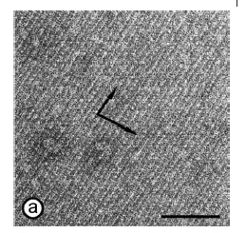
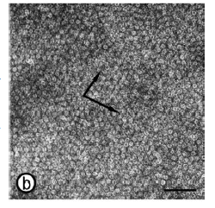
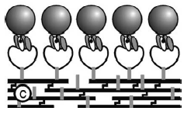
Chimeric S-layer
Figure : Cell wall fragments carrying a chimeric S-layer formed by the fusion protein BS1(S1)₃ (a) were capable of binding biotinylated ferritin (b). At BS1(S1)3, one core streptavidin is fused to the C-terminus of the S-layer protein SbsB of Geobacillus stearothermophilus PV72/p2. The proteins were refolded to heterotetramers consisting of one chain of fusion protein and three chains of streptavidin. (a) Self-assembly was enabled by the specific interaction between an accessory cell-wall polymer that is part of the cell wall of G. stearothermophilus PV72/p2, and the SLH domain of the fusion protein. (b) Bound biotinylated ferritin reflected the underlying S-layer lattice. The preparations were negatively stained with uranyl acetate for TEM. The arrows indicate the base vectors of the oblique p1 lattice; scale bars =100 nm. (c) The cartoon shows the orientation of BS1(S1)₃ after SLH-enabled self-assembly with the streptavidin carrying outer face of the S-layer exposed.(Reproduced from Ref. [45]; copyright (2002) National Academy of Sciences,USA.)

Slide 10
Features of fusion protein
The fusion proteins and core-streptavidin were produced independently in Escherichia coli, isolated and refolded to heterotetramers consisting of one chain of fusion protein and three chains of streptavidin.
As determined by a fluorescence titration method, the biotin binding capacity of the heterotetramers was 80% in comparison to homotetrameric streptavidin, indicating that at least three of the four core streptavidin residues were accessible and active.
Due to the ability of the heterotetramers to recrystallize in suspension, on liposomes, and on silicon wafers, this chimeric S-layer can be used as self-assembling nanopatterned molecular affinity matrix to arrange biotinylated compounds on a surface

Slide 11
Assembly
A complete solubilization of S-layers into their constituent subunits achieved with high concentrations of hydrogen bond-breaking agents (e. g., guanidine hydrochloride).
From results of disintegration procedures, it was concluded:
S-layer proteins not covalently linked to each other or supporting cell wall
Combinations of weak bonds (hydrophobic bonds, ionic bonds, and hydrogen bonds), responsible for the structural integrity of S-layers
Bonds holding the S-layer subunits together are stronger than those binding the S-layer lattices to the underlying envelope layer or membrane

